Slide 1

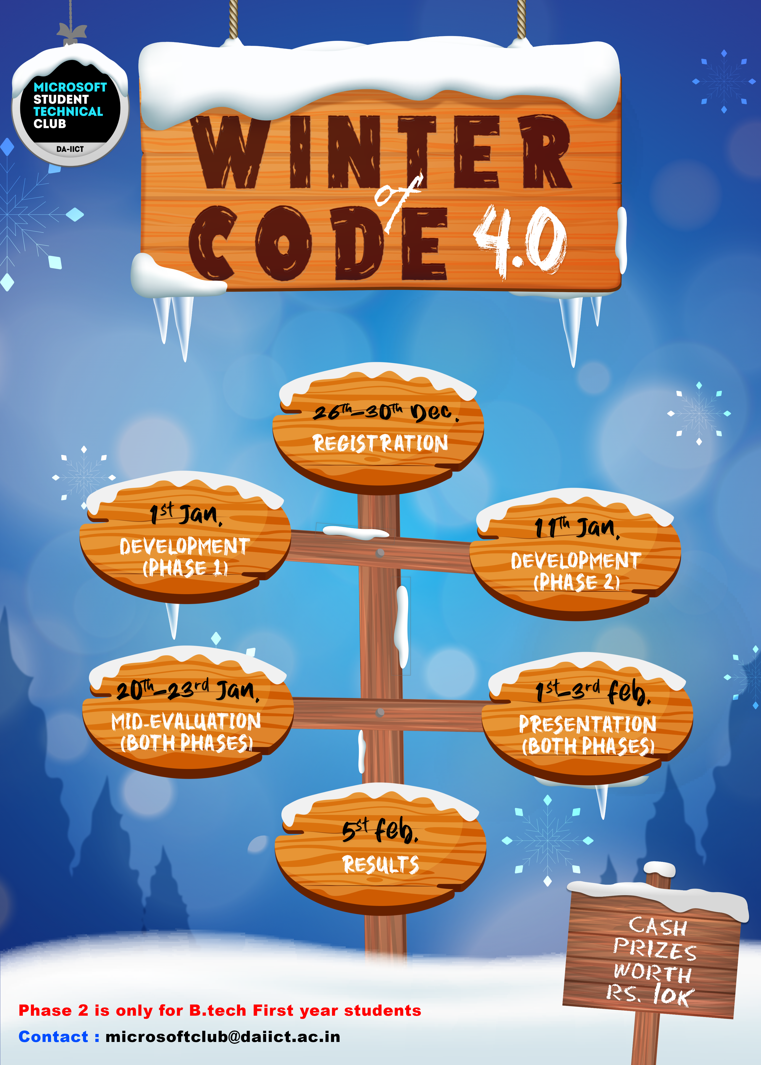
API Based News App
A simple REST API based News Application
Project link:
https://github.com/solanki-bhavya/woc4.0-android-newsapp-Bhavya

Slide 2
Overview
A simple news application that fetches country based top headlines and classifies them into various categories.
Easy to use UI that leads to better User Experience

Slide 3
Software and Technology Requirement
Basic Java Programming Language with knowledge of OOP concepts
Android Studio (Standard tool for developing Android Applications
Glide (For handling images smoothly)
Retrofit (For handling API functionalities)

Slide 4
Let’s Talk something About UI
This Application is consists of total 2 screens (it contains 2 activities)
Main Activity and Detailed News Activity
Main Activity’s UI has components like Toolbar, Tab Layout, and 6 Fragments for 6 categories (Home, Sports, Health, Science, Entertainment and Technology).
Detailed Activity’s UI has components like Toolbar and a WebView.

Slide 5

Components of Main Layout
Tool Bar
TabLayout
View Pager
Or
Fragment Container

Slide 6

Components of Detailed Layout
Tool Bar

Slide 7


Components of a Fragment

Slide 8
News API Request and Response
Request Parameters
Apikey
Country
Category
Page Size
Sources
Page
q
Response Object
Status
Total Results
Articles
Source
Title
Description
url
Url To Image
Published At
content

Slide 9
Simple API Request
For Home Fragment (Top headline of any category)
@GET("top-headlines")
Call<NewsResponse> getNews(@Query("country") String country,@Query("pageSize") int pageSize,@Query("apikey") String apiKey);
For Other Fragment (Top headline of particular category)
@GET("top-headlines")
Call<NewsResponse> getCategoryNews(@Query("country") String country,@Query("category") String category,@Query("pageSize") int pageSize,@Query("apikey") String apiKey);

Slide 10
API Response
{
"status": "ok",
"totalResults": 38,
"articles": [
{
"source": {
"id": null,
"name": "New York Times"
},
"author": "Ian Austen, Vjosa Isai",
"title": "Covid-19 Live Updates: Vaccines and Testing News - The New York Times",
"description": "Protesters against pandemic-related measures have paralyzed Ottawa for a week and arrived in Toronto. President Erdogan of Turkey tested positive after meeting Ukraine’s president. CVS and Walgreens lift limits on buying at-home tests.",
"url": "https://www.nytimes.com/live/2022/02/05/world/covid-test-vaccine-cases",
"urlToImage": "https://static01.nyt.com/images/2022/02/05/world/05virus-briefing-promo3/05virsu-briefing-promo3-facebookJumbo.jpg",
"publishedAt": "2022-02-06T02:39:00Z",
"content": "Senator Rand Paul of Kentucky was one of several Republicans in Congress who dined at a Washington bar shortly after it was ordered closed by the citys health department.Credit...Stefani Reynolds for… [+3992 chars]"
}
]
}

Slide 11
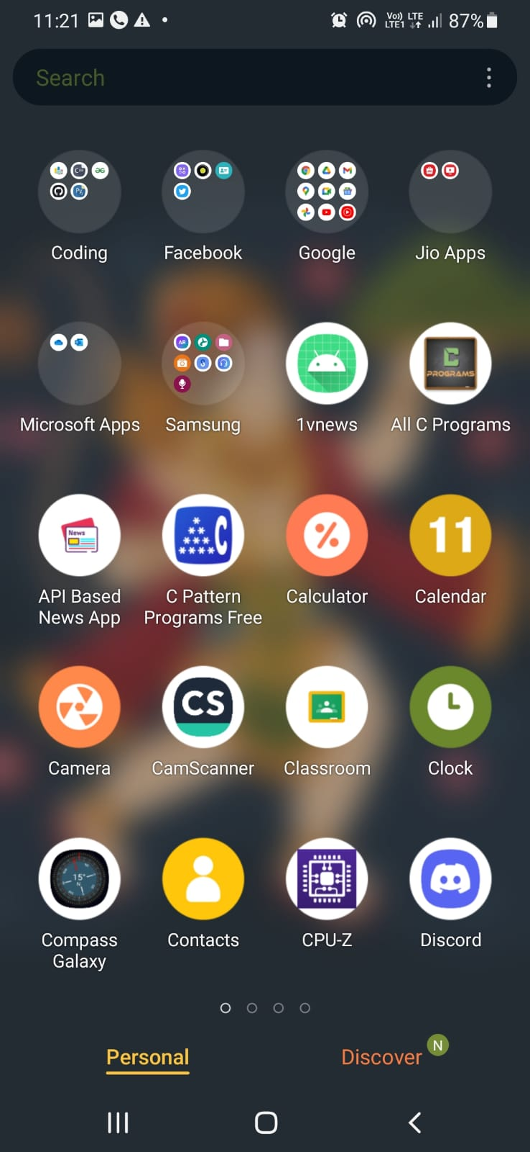
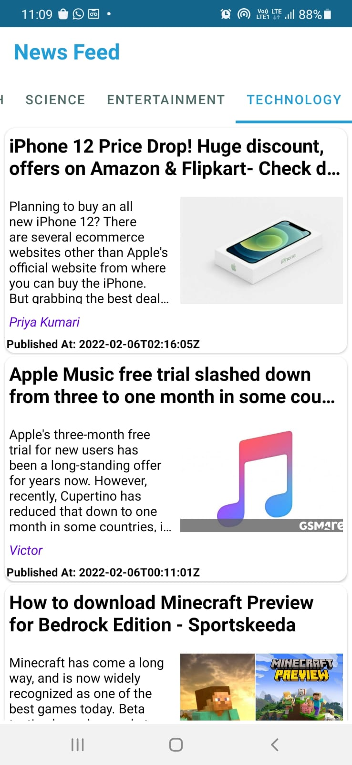
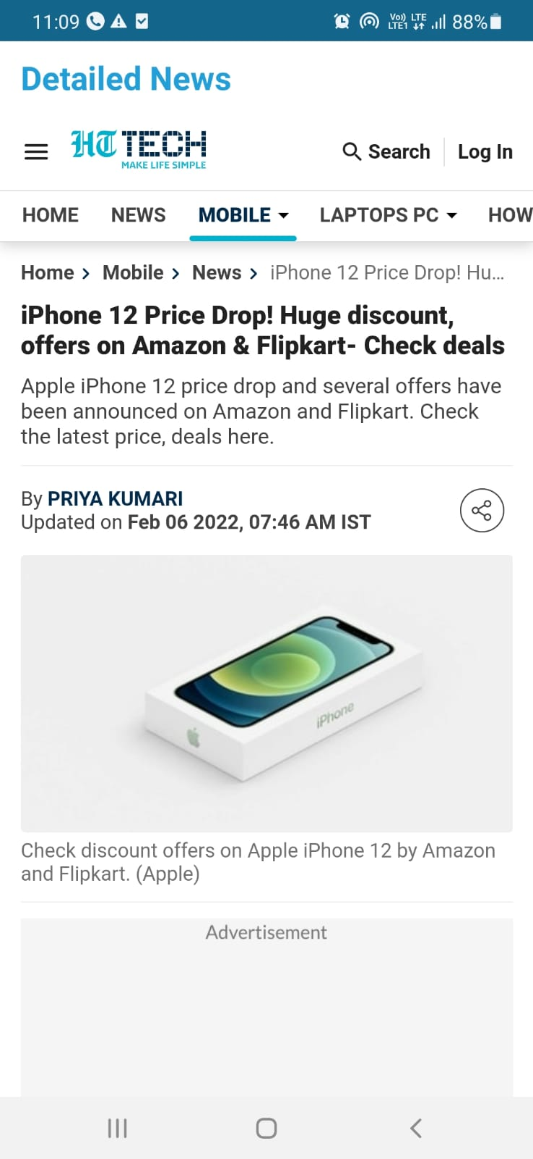

Slide 12
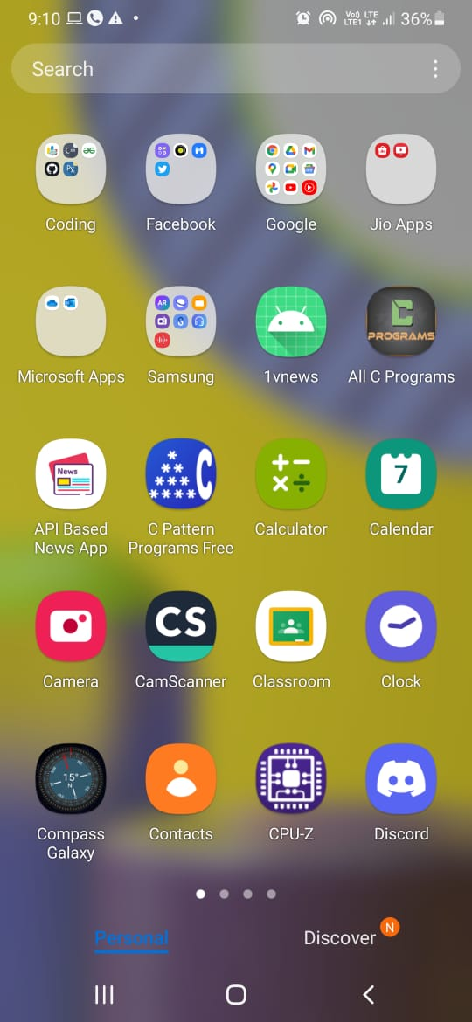
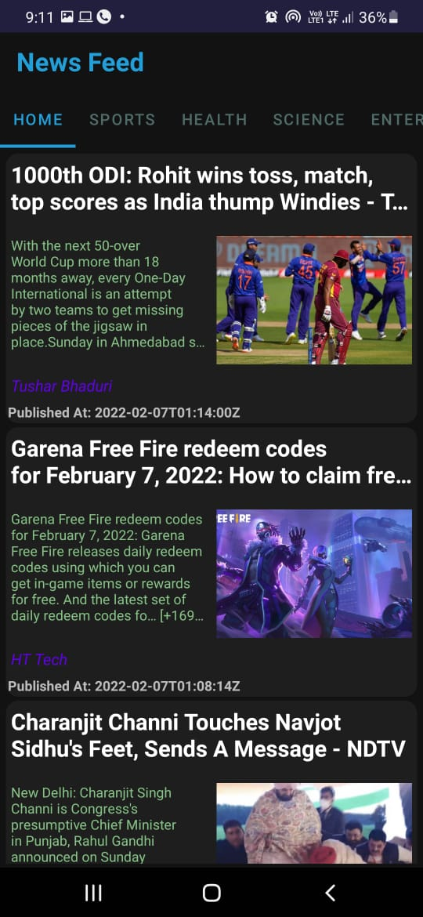
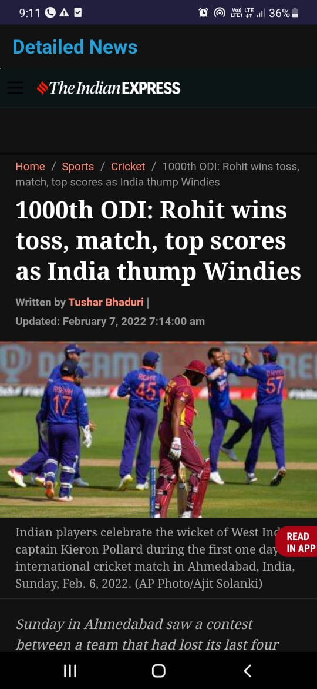
Dark Mode

Slide 13
Last but not the least
Thanks to all Mentors:
Krunal Chhagani
Advait Acharya
Sarthak Patel
Vidhi Badrakiya
Adit Shah
Thank You MSTC DAIICT for WOC 4.0

Slide 14
Thank You
201901131

